Slide 1
4th-order Runge Kutta and the Dormand-Prince Methods
Douglas Wilhelm Harder, M.Math. LEL
Department of Electrical and Computer Engineering
University of Waterloo
Waterloo, Ontario, Canada
ece.uwaterloo.ca
dwharder@alumni.uwaterloo.ca
© 2012 by Douglas Wilhelm Harder. Some rights reserved.

Slide 2
Outline
This topic discusses advanced numerical solutions to initial value problems:
Weighted averages and integration techniques
Runge-Kutta methods
4th-order Runge Kutta
Adaptive methods
The Dormand-Prince method
The Matlab ode45 function

Slide 3
Outcomes Based Learning Objectives
By the end of this laboratory, you will:
Understand the 4th-order Runge-Kutta method
Comprehend why adaptive methods are required to reduce the error but also reduce the effort
Understand the algorithm for the Dormand-Prince method

Slide 4
Weighted Averages
The average of five numbers x₁, x₂, x₃, x₄, and x₅ is:
Suppose these were project grades and the last two projects had twice the weight of the other projects
We can calculate the following weighted average:

Slide 5
Weighted Averages
In fact, any combination scalars of a₁, a₂, a₃, a₄, and a₅ such that
allows us to calculate the weighted average
It is also possible to have negative weights:
Richardson extrapolation weights:

Slide 6
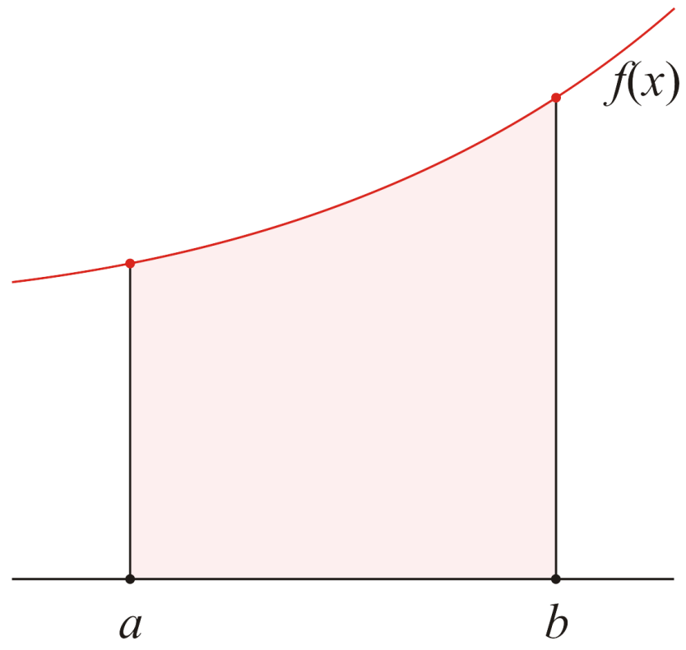
Integration
We will motivate this next idea by looking at approximating integrals
We wish to approximate

Slide 7
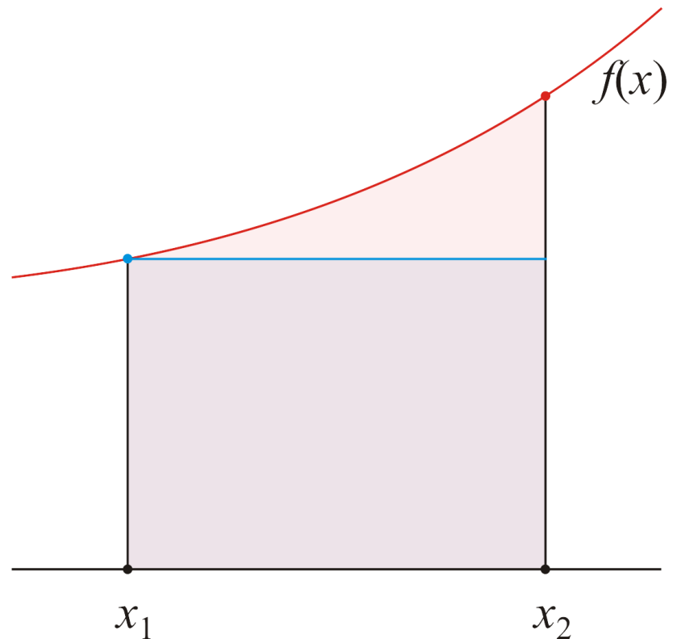
Integration
In first year, you would have seen the approximation:
Approximate the integral by calculating the area of the square
a =
= b

Slide 8
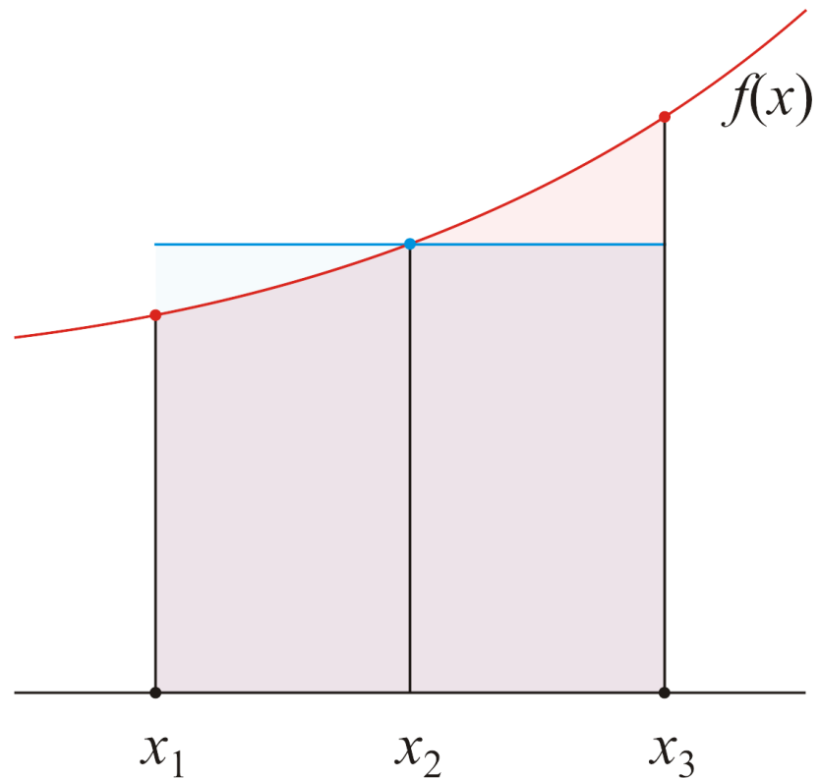
Integration
Alternatively, you could use the mid-point:
a =
= b

Slide 9
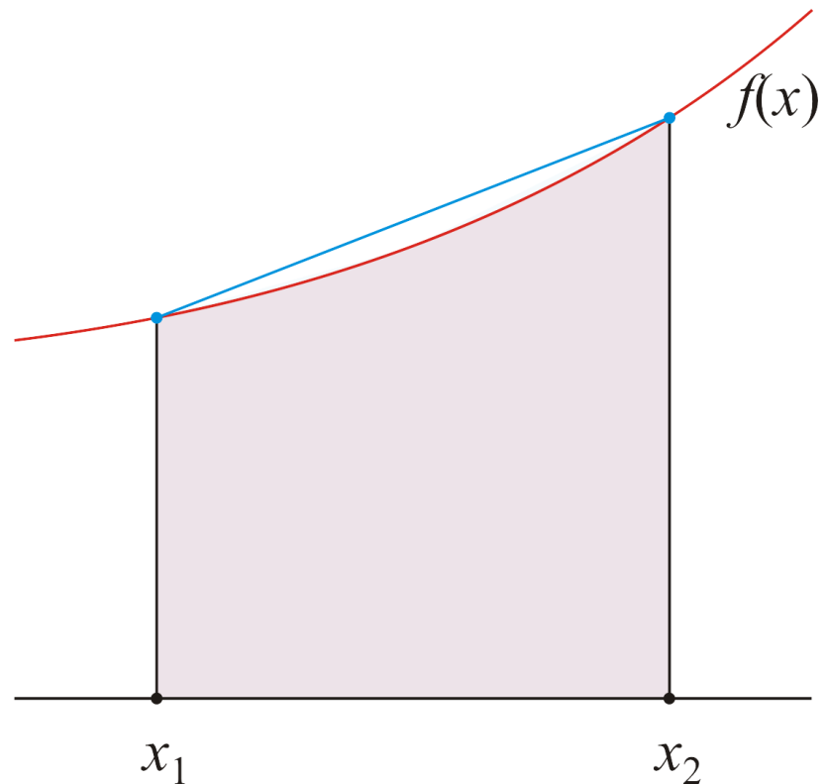
Integration
Or, take a weighted average of the two end points
This weighted average calculates the area of the trapezoid
The trapezoidal rule
a =
= b

Slide 10

Integration
We could take a weighted average of three points
This calculates the area of two trapezoids
The composite
trapezoidal rule
a =
= b

Slide 11
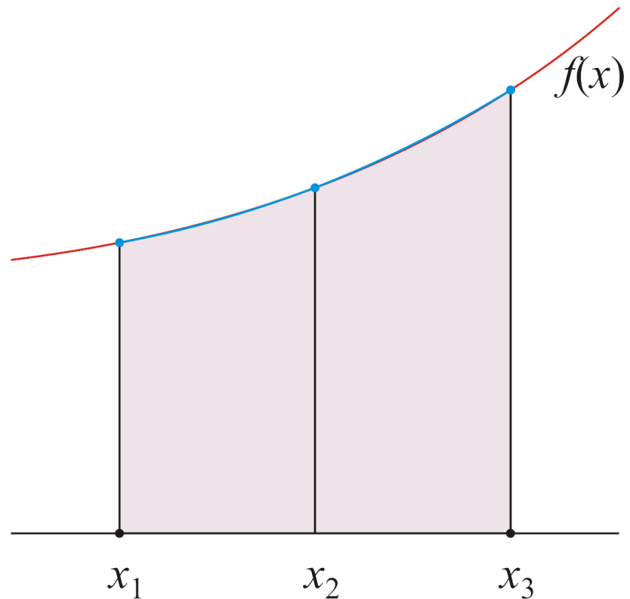
Integration
A better approximation is to give more weight to the mid point
This calculates the area under the interpolating quadratic function
Simpson’s rule
a =
= b

Slide 12

Integration
We can increase the number of points and use other weights
This calculates the area under the interpolating quadratic function
Simpson’s ³/₈ rule
a =
= b

Slide 13
Initial-value Problems
We will use the same weighted average idea to find better approximations of an initial-value problem
In the last laboratory, we saw
Euler’s method
Heun’s method
In this laboratory, we will see:
The 4th-order Runge Kutta method
The Dormand-Prince method
Both use weighted averages

Slide 14
Initial-value Problems
Recall that given a 1st-order ordinary-differential equation and an initial condition
Then, given an initial condition
we would like to approximate a solution

Slide 15
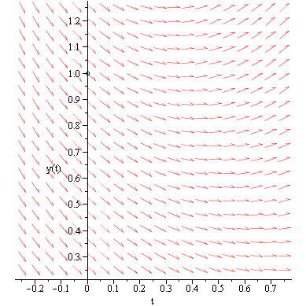
Initial-value Problems
For example, consider

Slide 16
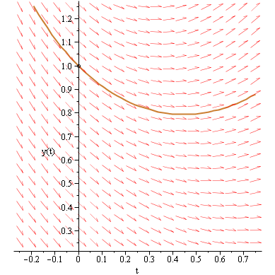
Initial-value Problems
For example, consider

Slide 17
Euler’s Method
Euler’s method approximates the slope by taking one sample:
This slope is then used to approximate the next point:

Slide 18
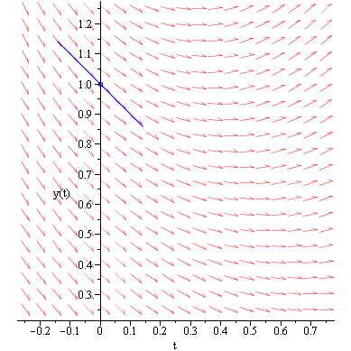
Euler’s Method
In our example, if h = 0.5, we would calculate this slope

Slide 19
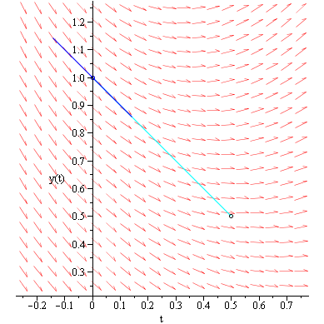
Euler’s Method
We follow this slope a distance h = 0.5 out:

Slide 20
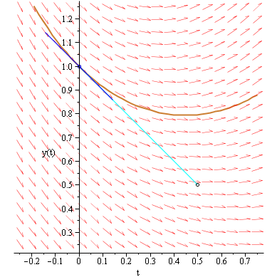
Euler’s Method
The approximation is not great if h is too large:

Slide 21
Heun’s Method
Heun’s method approximates the slope by taking two samples:
The average of the two slopes is used to approximate the next point:

Slide 22
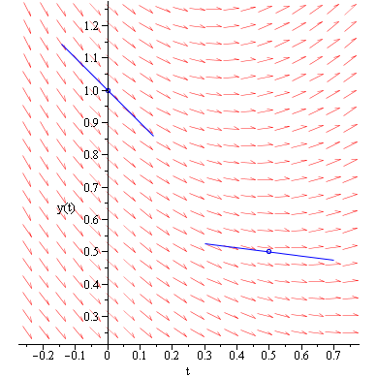
Heun’s Method
For Heun’s method, we calculate a second slope:

Slide 23
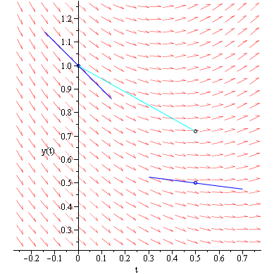
Heun’s Method
Take the average, and follow this average slope out:

Slide 24
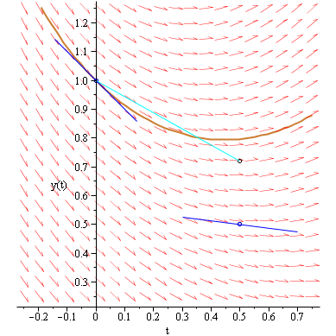
Heun’s Method
The approximation is better than Euler’s method

Slide 25
Mid-point Method
One idea we did not look at was the midpoint method:
Use Euler’s method to find in the slope in the middle with h/2:
This second slope is then used to approximate the next point:

Slide 26
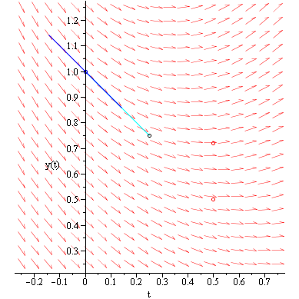
Mid-point Method
Use Euler’s method to find a point going out h/2:

Slide 27
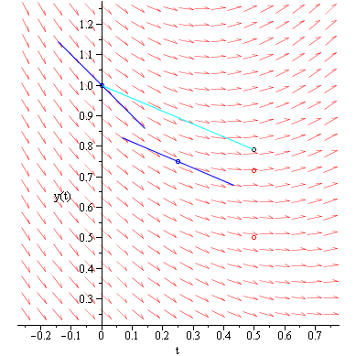
Mid-point Method
Calculate the slope and use this to approximate y(0.5):

Slide 28
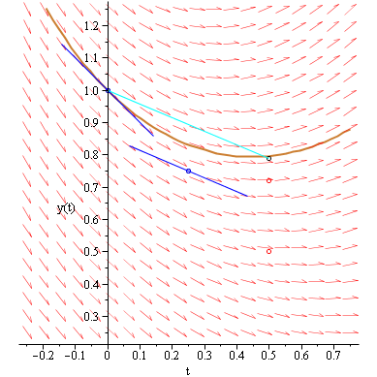
Mid-point Method
The approximation is better than Heun’s

Slide 29
4th-order Runge-Kutta Method
The 4th-order Runge Kutta method is similar; again, starting at the midpoint t_{k} + h/2:

Slide 30
4th-order Runge-Kutta Method
However, we then sample the mid-point again:

Slide 31
4th-order Runge-Kutta Method
We use this 3rd slope to find a point at t_{k} + h:

Slide 32
4th-order Runge-Kutta Method
We then use a weighted average of these four slopes
and approximate
Compare with Heun’s method:

Slide 33
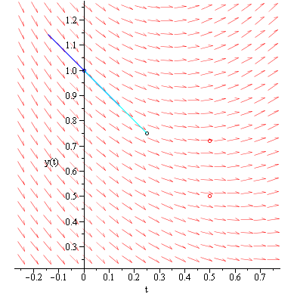
4th-order Runge-Kutta Method
Follow the slope to the mid-point

Slide 34
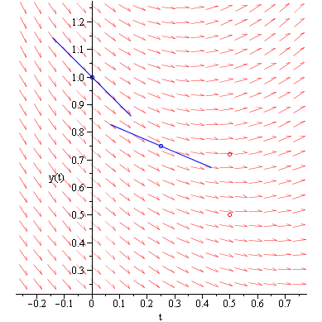
4th-order Runge-Kutta Method
Determine this slope, K₂:

Slide 35
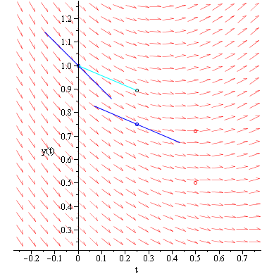
4th-order Runge-Kutta Method
Follow the slope K₂ out a distance h/2:

Slide 36
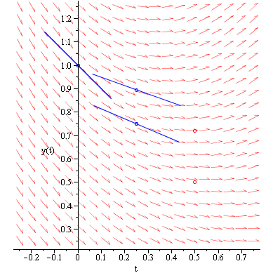
4th-order Runge-Kutta Method
Determine this slope, K₃:

Slide 37
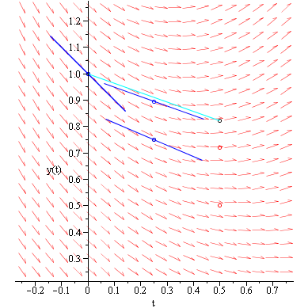
4th-order Runge-Kutta Method
Follow the slope K₃ out a distance h:

Slide 38
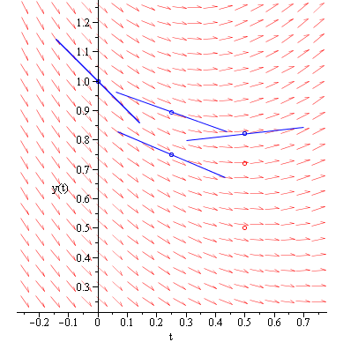
4th-order Runge-Kutta Method
Determine this slope, K₄:

Slide 39
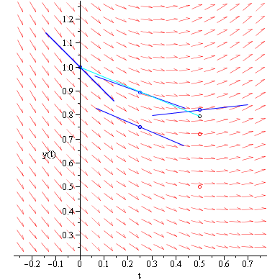
4th-order Runge-Kutta Method
Take a weighted average of the four slopes:

Slide 40
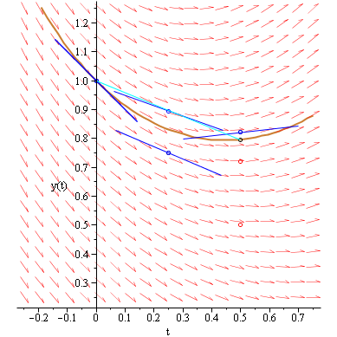
4th-order Runge-Kutta Method
The approximation looks pretty good:

Slide 41
4th-order Runge-Kutta Method
Let’s compare the approximations:
Euler: 0.5
Heun: 0.71875
Mid-point: 0.7890625
4th-order R-K: 0.79620615641666···

Slide 42
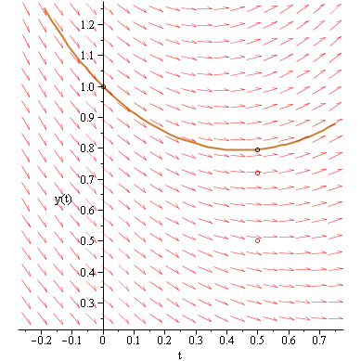
4th-order Runge-Kutta Method
Remember, however, this took four function evaluations

Slide 43
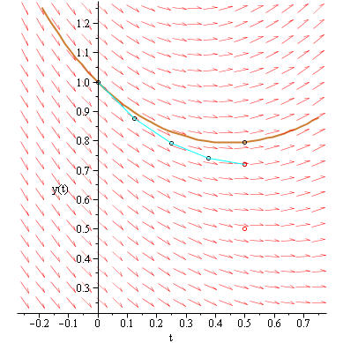
4th-order Runge-Kutta Method
Four steps of Euler’s method is about as good as Heun’s

Slide 44
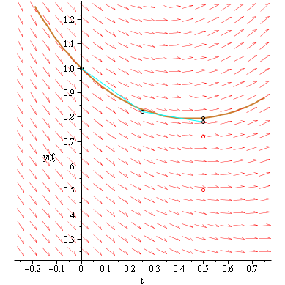
4th-order Runge-Kutta Method
Even two steps of Heun’s method isn’t as accurate

Slide 45
4th-order Runge-Kutta Method
As an example,
>> format long
>> [t2a, y2a] = rk4( @f2a, [0, 1], 0, 2 )
t2a =
0 1
y2a =
0 0.265706380208333
>> [t2a, y2a] = rk4( @f2a, [0, 1], 0, 3 )
t2a =
0 0.500000000000000 1.000000000000000
y2a =
0 0.227653163407674 0.251787629335613
>> [t2a, y2a] = rk4( @f2a, [0, 1], 0, 4 )
t2a =
0 0.333333333333333 0.666666666666667 1.000000000000000
y2a =
0 0.190364751129471 0.243328110416578 0.250335465183716

Slide 46
4th-order Runge-Kutta Method
This is easily enough implemented in Matlab:
for k = 1:(n – 1)
% Find the four slopes K1, K2, K3, K4
% Given y(k), find y(k + 1) by adding % h times the weighted average end

Slide 47
Runge-Kutta Methods
Carl Runge and Martin Kutta observed that, given the first slope
we can approximate a second slope:
where usually , although we will allow c₂ > 1

Slide 48
Runge-Kutta Methods
Given these two slopes, we can approximate a third:
where defines a weighted average
At this point, we could take a weighted average of K₁, K₂ and K₃ to approximate the next point:
where

Slide 49
Runge-Kutta Methods
The values of these coefficients for 4th-order R-K are:
A = [0 0 0 0
1 0 0 0
0 1 0 0
0 0 1 0]';
c = [0 1/2 1/2 1]';
b = [1/6 1/3 1/3 1/6];

Slide 50
Runge-Kutta Methods
Using these vectors, we simply access them...
A = [0 0 0 0
1 0 0 0
0 1 0 0
0 0 1 0]';
c = [0 1/2 1/2 1]';
b = [1/6 1/3 1/3 1/6]';
t0 = t_rng(1);
tf = t_rng(2);
h = (tf - t0)/(n - 1);
t_out = linspace( t0, tf, n );
y_out = zeros( 1, n );
y_out(1) = y0;
k_n = 4;
for k = 1:(n - 1)
K = zeros( 1, k_n );
for m = 1:k_n
K(m) = f( t_out(k) + h*c(m), ...
y_out(k) + h*c(m)*K*A(:,m) );
end
y_out(k + 1) = y_out(k) + h*K*b;
end

Slide 51
Butcher Tableau
These tables are referred to as Butcher tableaus:
For Heun’s method:
For the 4th-order Runge-Kutta method:

Slide 52
Butcher Tableau
Some Butcher tableaus multiply out the scalars:

Slide 53
Comparison
Let’s approximate the solutions to last weeks IVPs:
The initial-value problem
has the solution
function [dy] = f2a(t, y)
dy = (y - 1).^2 .* (t - 1).^2;
end
function [y] = y2a( t )
y = (t.^3 - 3*t.^2 + 3*t)./(t.^3 - 3*t.^2 + 3*t + 3);
end

Slide 54
Comparison
Being fair, let’s keep the number of function evaluations the same:
Euler: n = 17
Heun: n = 9
4th-order Runge Kutta n = 5
n = 4;
[t2e, y2e] = euler( @f2a, [0, 1], 0, 4*n+1 );
[t2h, y2h] = heun( @f2a, [0, 1], 0, 2*n+1 );
[t2r, y2r] = rk4( @f2a, [0, 1], 0, n+1 );
t2s = linspace( 0, 1, 101 );
plot( t2e, y2e, 'r.' )
hold on
plot( t2h, y2h, 'd' )
plot( t2r, y2r, 'mo' )
plot( t2s, y2a( t2s ), 'k' )

Slide 55
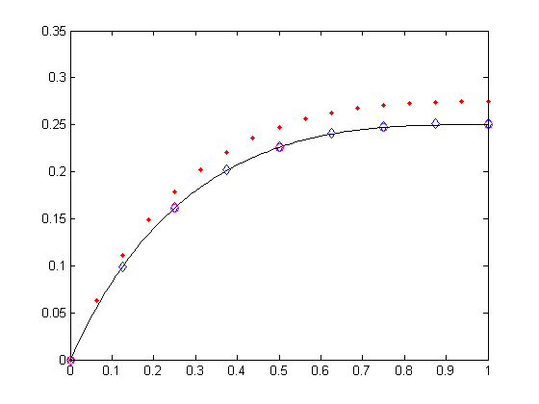
Comparison
With this IVP, it is difficult to tell which is better at such a scale:
Euler • 4th-order Runge Kutta o
Heun ◊ ode45 ___

Slide 56
Comparison
Instead, let’s plot the logarithm base 10 of the absolute errors for a greater number of points:
n = 20;
[t2e, y2e] = euler( @f2a, [0, 1], 0, 4*n+1 );
[t2h, y2h] = heun( @f2a, [0, 1], 0, 2*n+1 );
[t2r, y2r] = rk4( @f2a, [0, 1], 0, n+1 );
t2s = linspace( 0, 1, 101 );
plot( t2e, log10(abs(y2e - y2a( t2e ))), '.r' )
hold on
plot( t2h, log10(abs(y2h - y2a( t2h ))), '.b' )
plot( t2r, log10(abs(y2r - y2a( t2r ))), '.m' )

Slide 57
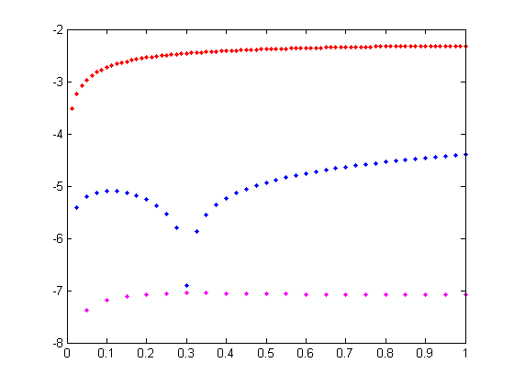
Comparison
Comparing the errors:
The error for Euler’s method is around 10^{–2}
Heun’s method has an error around 10^{–5}
The 4th-order Runge-Kutta method has an error around 10^{–7}
Euler
Log of Error
Heun
4th-order Runge Kutta

Slide 58
4th-order Runge Kutta
The other initial value problem we looked at was:
There is no analytic solution, so we had to use ode45:
n = 4;
[t2e, y2e] = euler( @f2b, [0, 1], 1, 4*n+1 );
[t2h, y2h] = heun( @f2b, [0, 1], 1, 2*n+1 );
[t2r, y2r] = rk4( @f2b, [0, 1], 1, n+1 );
[t2o, y2o] = ode45( @f2b, [0, 1], 1 );
plot( t2e, y2e, 'r.' )
hold on
plot( t2h, y2h, 'bd' )
plot( t2r, y2r, 'mo' )
plot( t2o, y2o, 'k' )

Slide 59
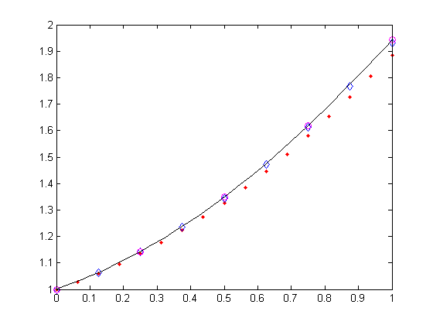
Comparison
With this IVP, it is difficult to tell which is better at such a scale:
Euler • 4th-order Runge Kutta o
Heun ◊ ode45 ___

Slide 60
Comparison
Instead, let’s again look at the logarithms of the absolute errors:
n = 20;
[t2e, y2e] = euler( @f2b, [0, 1], 1, 4*n+1 );
[t2h, y2h] = heun( @f2b, [0, 1], 1, 2*n+1 );
[t2r, y2r] = rk4( @f2b, [0, 1], 1, n+1 );
options = odeset( 'RelTol', 1e-13, 'AbsTol', 1e-13 );
[t2o, y2o] = ode45( @f2b, [0, 1], 1, options );
plot( t2e, log10(abs(y2e - interp1( t2o, y2o, t2e ))), '.r' )
hold on
plot( t2h, log10(abs(y2h - interp1( t2o, y2o, t2h ))), '.b' )
plot( t2r, log10(abs(y2r - interp1( t2o, y2o, t2r ))), '.m' )
We compare our approximations with the built-in ode45 function with very high relative and absolute tolerances

Slide 61
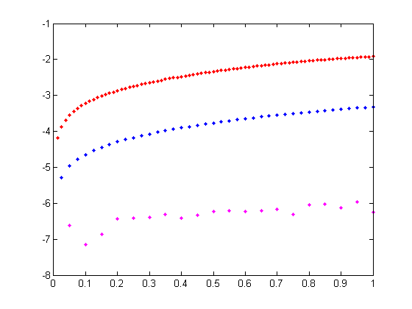
Comparison
Again, comparing the errors:
The error for Euler’s method is around 10^{–2}
Heun’s method has an error around 10^{–4}
The 4th-order Runge-Kutta method has an error around 10^{–6}
Euler
Heun
Log of Error
4th-order Runge Kutta

Slide 62
The Dormand-Prince Method
With this general implementation of Runge-Kutta methods, we may now go on to the current algorithm used in Matlab today
The routine ode45 uses the Dormand-Prince method

Slide 63
The Dormand-Prince Method
Consider the ODE described by:
This does not have a closed-form solution
The best Maple can do is give an answer in terms of an integral:
> dsolve( {D(y)(t) = y(t)*(2 - t)*t + t - 1, y(0) = 1} );
No antiderivative

Slide 64
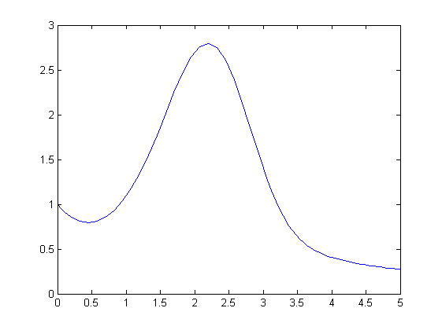
The Dormand-Prince Method
In Matlab, we would implement
function [dy] = f3a( t, y ) dy = y*(2 - t)*t + t - 1; end
And then call:
>> [t3a, y3a] = ode45( @f3a, [0, 5], 1 );
>> plot( t3a, y3a );

Slide 65
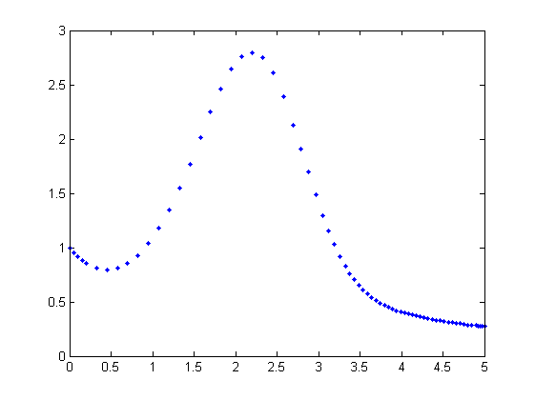
The Dormand-Prince Method
One interesting observation:
>> plot( t3a, y3a, '.' );
The points appear to be more tightly packed at the right
Dormand-Prince is adaptive—it attempts to optimize the interval size

Slide 66
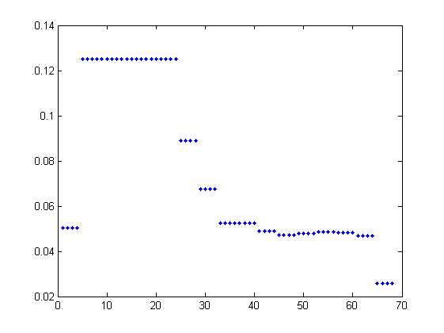
The Dormand-Prince Method
There are 69 points:
>> length( t3a );
ans = 69
>> plot( diff( t3a ), '.' );

Slide 67
Adaptive Techniques
How does the algorithm know when to change the size of the interval?
Suppose we have two algorithms, one known to be better than the other:
For example, Euler’s method and Heun’s method
Given a point (t_{k}, y_{k}), use both methods to approximate the next point:
Euler’s method
Heun’s method

Slide 68
Adaptive Techniques
As a very simple example, consider:
Suppose we want to ultimately approximate y(0.1) so we start with h = 0.1 and we want to ensure that the error is not larger than ε_{abs} = 0.001
Euler’s method
Heun’s method

Slide 69
Adaptive Techniques
Thus, we have two approximations:
One is okay, the other is better
The actual value is e^{–0.1} = 0.9048374180···
The actual error of y_{tmp} is
Using z_{k + 1}, our approximation of the error is

Slide 70
Adaptive Techniques
This suggests that we can use as an approximation of the error of y_{tmp}
Problem: this error is larger than the error we were willing to tolerate
In this case, the error should be less than ε_{abs} = 0.001
Solution: choose a smaller value of h
Question: how much smaller?

Slide 71
Adaptive Techniques
First, we know that the error of Euler’s method is O(h²), that is
for some value of C
If we scale h by some factor s, the error will be C(sh)²:

Slide 72
Adaptive Techniques
However, we want final error to be less than ε_{abs}
The contribution of the maximum error at the k^{th} step should be proportional to the width of the interval relative to the whole interval
Our modified goal: we want
Just to be sure, find a value of s such that

Slide 73
Adaptive Techniques
We now have two equations:
Expand the second:
We can now substitute the first equation for Ch²:

Slide 74
Adaptive Techniques
Given the equation
we can solve for s to get

Slide 75
Adaptive Techniques
In this particular example:
and thus we find that
To get the accuracy we want, we need a smaller value of h

Slide 76
Adaptive Techniques
Now, using h = 0.01, we get
The actual value is e^{–0.031} = 0.9900498337···
The absolute error using Euler’s method is 0.0000498337··· which is of the same order of
Use y_{tmp} as the approximation y_{k + 1}
Euler’s method
Heun’s method

Slide 77
Adaptive Techniques
If we repeat this process, we get the output
>> t_out =
0 0.0100 0.0200 0.0301 0.0403 0.0506 0.0610 0.0715 0.0822 0.0929 0.1
>> y_out =
1 0.9900 0.9801 0.9702 0.9603 0.9504 0.9405 0.9306 0.9207 0.9108 0.9044
>> format long
>> y_out(end)
0.904837418035960
>> exp( -0.1 )
0.904837418035960
>> abs( y_out(end) - exp( -0.1 ) )
4.599948547183708e-004

Slide 78
Adaptive Techniques
In general, however, it isn’t always a good idea to update
h = s*h;
as s could be either very big or very small
It is safer to be a little conservative—do not expect h to change too much in the short run:
If s ≥ 2, double the value of h
If 1 ≤ s < 2, leave h unchanged, and
If s < 1, halve h and try again

Slide 79
The Dormand-Prince Method
Dormand-Prince calculates seven different slopes:
K₁, K₂, K₃, K₄, K₅, K₆, and K₇
These slopes are then used in two different linear combinations to find two approximations of the next point:
One is O(h⁴) while the other is O(h⁵)
The coefficients of the 5th-order approximate were chosen to minimize its error
We now use these two approximations to find s:

Slide 80
The Dormand-Prince Method
The modified Butcher tableau of the Dormand-Prince method is:
O(h⁴) approximation
O(h⁵) approximation

Slide 81
The Dormand-Prince Method
Each row sums to 1

Slide 82
The Dormand-Prince Method
Each row sums to 1
In the literature, for example, the fourth row would be multiplied by 4/5:

Slide 83
The Dormand-Prince Method
You can, if you want, use:
A = [ 0 0 0 0 0 0 0;
1 0 0 0 0 0 0;
1/4 3/4 0 0 0 0 0;
11/9 -14/3 40/9 0 0 0 0;
4843/1458 -3170/243 8056/729 -53/162 0 0 0;
9017/3168 -355/33 46732/5247 49/176 -5103/18656 0 0;
35/384 0 500/1113 125/192 -2187/6784 11/84 0]';
by = [5179/57600 0 7571/16695 393/640 -92097/339200 187/2100 1/40]';
bz = [ 35/384 0 500/1113 125/192 -2187/6784 11/84 0]';
c = [0 1/5 3/10 4/5 8/9 1 1]';

Slide 84
The Dormand-Prince Method
All we need now are different matrices:
A = [...]';
c = [...]';
by = [...]';
bz = [...]';
// ...
n_K = 7;
K = zeros( 1, n_K );
for m = 1:n_K
K(m) = f( t_out(k) + h*c(m), ...
y_out(k) + h*c(m)*K*A(:,m) );
end
y_tmp = y_out(k) + h*K*by;
z_tmp = y_out(k) + h*K*bz;
% Determine s and modify h as appropriate

Slide 85
The Dormand-Prince Method
What value of h?
Previously, we specified the interval and the number of points
For Dormand-Prince, we will specify an initial value of h
ode45 actually determines a good initial value of h
We will not know apriori how many steps we will require
The value of h could increase or decrease depending on the problem
We will have to have a different counter tracking where we are in the array

Slide 86
The Dormand-Prince Method
We will therefore grow the vectors t_out and y_out:
>> t_out = 1
t_out =
1
>> t_out(2) = 1.1
t_out =
1.0000 1.1000
>> t_out(3) = 1.2
t_out =
1.0000 1.1000 1.2000
>> size( t_out )
ans =
1 3

Slide 87
The Dormand-Prince Method
Thus, the steps we will take:
% Initialize t_out and y_out
% Initialize our location to k = 1
%
% while t_out(k) < tf
% Use Dormand Prince to find two approximations
% y_tmp and z_tmp to approximate y(t) at
% t = t_out(k) + h for the current value of h
%
% Calculate the scaling factor 's'
%
% if s >= 2,
% We use z_tmp to approximate y_out(k + 1)
% t_out(k + 1) is the previous t-value plus h
% Increment k and double the value of h for the
% next iteration.

Slide 88
The Dormand-Prince Method
% else if s >= 1,
% We use z_tmp to approximate y_out(k + 1)
% t_out(k + 1) is the previous t-value plus h
% In this case, h is neither too large or too
% small, so only increment k
% else s < 1
% Divide h by two and try again with the smaller
% value of h (just go through the loop again
% without updating t_out, y_out, or k)
% end
%
% We must make one final check before we end the loop:
% if t_out(k) + h > tf, we must reduce the
% size of h so that t_out(k) + h == tf
% end

Slide 89
Runge-Kutta Methods
As an example,
>> format long
>> [t2a_out, y2a_out] = dp45( @f2a, [0, 1], 0, 0.1, 0.001 )
t2a_out =
0 0.100000000000000 0.300000000000000 0.700000000000000 1.000000000000000
y2a_out =
0 0.082849238339751 0.179654557289050 0.244899192641371 0.249996176157670
>> [t2a_out, y2a_out] = dp45( @f2a, [0, 1], 0, 0.1, 0.0001 )
t2a_out =
0 0.100000000000000 0.300000000000000 0.500000000000000 0.900000000000000 1.000000000000000
y2a_out =
0 0.082849238339751 0.179654557289050 0.225805610339612 0.249811473416968 0.249999020845017

Slide 90
Runge-Kutta Methods
In the 2nd example, the values of K, y, z, and s at the four steps are
t₁ = 0.0
h = 0.1
Approximating t₂ = 0.1
y_{tmp} = 0.082849167706690
z_{tmp} = 0.082849238339751
s = 2.900617713421327
Note: y_{2a}(0.1) = 0.082849281565271
Note: double the value of h for the next interval...

Slide 91
Runge-Kutta Methods
In the 2nd example, the values of K, y, z, and s at the four steps are
t₂ = 0.1
h = 0.2
Approximating t₃ = 0.3
y_{tmp} = 0.179652821005170
z_{tmp} = 0.179654557289050
s = 1.549154799018235
Note: y_{2a}(0.3) = 0.179655455291222

Slide 92
Runge-Kutta Methods
In the 2nd example, the values of K, y, z, and s at the four steps are
t₃ = 0.3
h = 0.2
Approximating t₄ = 0.5
y_{tmp} = 0.225805183165541
z_{tmp} = 0.225805610339612
s = 2.199625668274607
Note: y_{2a}(0.5) = 0.225806451612903
Note: double the value of h for the next interval...

Slide 93
Runge-Kutta Methods
In the 2nd example, the values of K, y, z, and s at the four steps are
t₄ = 0.5
h = 0.4
Approximating t₅ = 0.9
y_{tmp} = 0.249809684810377
z_{tmp} = 0.249811473416968
s = 1.828642429049916
Note: y_{2a}(0.9) = 0.249812453113278
Note: but 0.9 + 0.4 > 1, so use h = 1 – 0.9 = 0.1

Slide 94
Runge-Kutta Methods
In the 2nd example, the values of K, y, z, and s at the four steps are
t₅ = 0.9
h = 0.1
Approximating t₆ = 1.0:
y_{tmp} = 0.249999020696080
z_{tmp} = 0.249999020845017
s = 13.536049392119093
Note: y_{2a}(1) = 0.25
Remember, we artificially reduced h

Slide 95
The Dormand-Prince Method
You will use the Dormand-Prince function in Labs 5 and 6 and in NE 217
Dormand-Prince is the algorithm used in the Matlab ODE solver
>> help ode45
ODE45 Solve non-stiff differential equations, medium order method.
[TOUT,YOUT] = ODE45(ODEFUN,TSPAN,Y0) with TSPAN = [T0 TFINAL]
integrates the system of differential equations y' = f(t,y) from
time T0 to TFINAL with initial conditions Y0.
ODEFUN is a function handle. For a scalar T and a vector Y,
ODEFUN(T,Y) must return a column vector corresponding to f(t,y).
Each row in the solution array YOUT corresponds to a time
returned in the column vector TOUT.

Slide 96
Summary
We have looked at solving initial-value problems with better techniques:
Weighted averages and integration techniques
4th-order Runge Kutta
Adaptive methods
The Dormand-Prince method

Slide 97
References
[1] Glyn James, Modern Engineering Mathematics, 4th Ed., Prentice Hall, 2007.
[2] Glyn James, Advanced Modern Engineering Mathematics, 4th Ed., Prentice Hall, 2011.
[3] J.R. Dormand and P. J. Prince, "A family of embedded Runge-Kutta formulae," J. Comp. Appl. Math., Vol. 6, 1980, pp. 19-26.

